Slide 1


Legal and Regulatory Review for CRVS Systems and Defense of Human Rights
Bloomberg Data for Health Initiative
Ashley Frederes
Senior Program Officer
Vital Strategies
Aaron Schwid
Senior Legal Advisor
Global Health Advocacy Incubator

Slide 2
The UN defines CRVS as the:
Continuous
Permanent
Compulsory
Universal
recording of the occurrence and characteristics of vital events

Slide 3
But CRVS laws tend to be:
Continuously Contradictory
Permanently Poorly-Written
Compulsively Complicated
Universally Unclear

Slide 4
Objective of CRVS Legal Analysis
Gather complete collection of laws related to CRVS
Compare current laws to international standards
Find problem areas and gaps in current legal framework
Brainstorm possible solutions with stakeholders
Divide solutions into those that require legislative changes and those that can be fixed with existing regulatory authority
Support government to enact desired legal improvements

Slide 5
The Assessment Tool
Self-taught tool designed for attorneys with limited to high knowledge of CRVS systems
Provides concise explanation of 42 international best practices and guidance for analyzing each
Designed to balance depth, comprehensiveness, ease-of-use and speed
Notes:
Philosophy: self-taught/self-led tool; comprehensive; objective standards; alignment with international BP; relatively quick for level of comprehensiveness

Slide 6
The Assessment Tool
42 best practices and principles with guidance
Which are covered by law?
Which are covered by regulation?
Where is there alignment and where are there gaps?
If gaps, can they be quickly patched by the agencies, or are legislative or other processes required?

Slide 7
Main Areas Covered
Enabling environment
Structure of Civil registrar
Technology & data security
Key issues with registration of birth, death, and foetal death
Key issues with certifying of cause of death
Production of vital statistics

Slide 8
International Best Practices
United Nations, Handbook on Civil Registration and Vital Statistics Systems Preparation of a Legal Framework, 1998
United Nations, Principles and Recommendations for a Vital Statistics System, 2014
World Health Organization, WHO Resource Kit: Strengthening civil registration and vital statistics for births, deaths and causes of death, 2010
Pacific Community, Legislation for Civil Registration and Vital Statistics in the Pacific: Best Practice Guidelines and Examples 2016
Notes:
Also: (i) UN handbook of VS systems and methods: legal, organization and technical aspects 1991; (ii) US Model Law 2011

Slide 9
International Obligations
Universal Declaration of Human Rights
Declaration on Rights of the Child
Convention of Reduction of Statelessness
International Convention on the Elimination of All Forms of Racial Discrimination
International Covenant on Civil and Political Rights
Many more…

Slide 10
Depth of Law Implicated
Court decisions
Constitution
Laws/Statutes
Administrative instruments (eg regulations, decrees orders, SOPs)

Slide 11
Breadth of law implicated
Government Administration
Constitution
Government Organization
Civil Procedure and Civil Code
Local Government
Administrative Procedures
Criminal Procedure and Penal Code
Local Autonomy Laws
Budget
Code of Conduct of Government Officials
Initial Information Collection
Individual or Family Registration
Paternity
Hygiene and disease prevention
Burial and Cremation
Nationality
Residence registration
Education or student registration
Civil Information Management
Public security law
Information Management
Personal Information Protection
Electronic Government
Telecommunications
Digital Signature
Notary Offices
Certificate of Seal Imprint
Judicial Enforcement
Medical Procedures and Rules
Medical School curriculum
Government hospital manuals
Medical Board Training Requirements and Procedures
Coroner or Autopsy or Inquest
Statistics and Other Secondary Uses
Statistics or Censuses
Heritage and basis of Inheritance
Education
National and Local Tax Collection
Military Service
National Health
Social Security
Emigration and Immigration
Voting and Elections
Registration of Real Estate
Labor
Other considerations
Religious freedom
Human rights
Protection of rights of children
Protection of rights of women
Specific diseases such as HIV/AIDS
Drugs and medical products

Slide 12
Who Benefits?
Public
Health Sector
Clear delineation of roles
Smooth government interactions
Access to quality statistics data
CRVS
Nat'l Gov't
Easy, quick, free, universal registration
Exercise individual benefits of registration
Clear, efficient, and cost-effective procedures
High-quality data
Legal application of verbal autopsy
Other Gov't Agencies
Reliable validation for ID, immigration, voting, education, pensions, driving, police and more
Private Companies
Confidence in customers' identity
Notes:
Public –
National government – Smooth government functioning
Registrars– Clear, efficient procedures
Health – Access to quality statistics data
Other govt agencies – validation of ID, voting, education, pensions, driving, police, other
Private companies – confidence in identity

Slide 13
Options following a legal analysis
Revise operating procedures and training manuals – without fear of violating law
Issue or amend sub-decrees and regulations
Support revision of CRVS legislation
Encourage amendment of related law or regulations
Produce new registration forms and/or introduce international standard MCCOD form

Slide 14
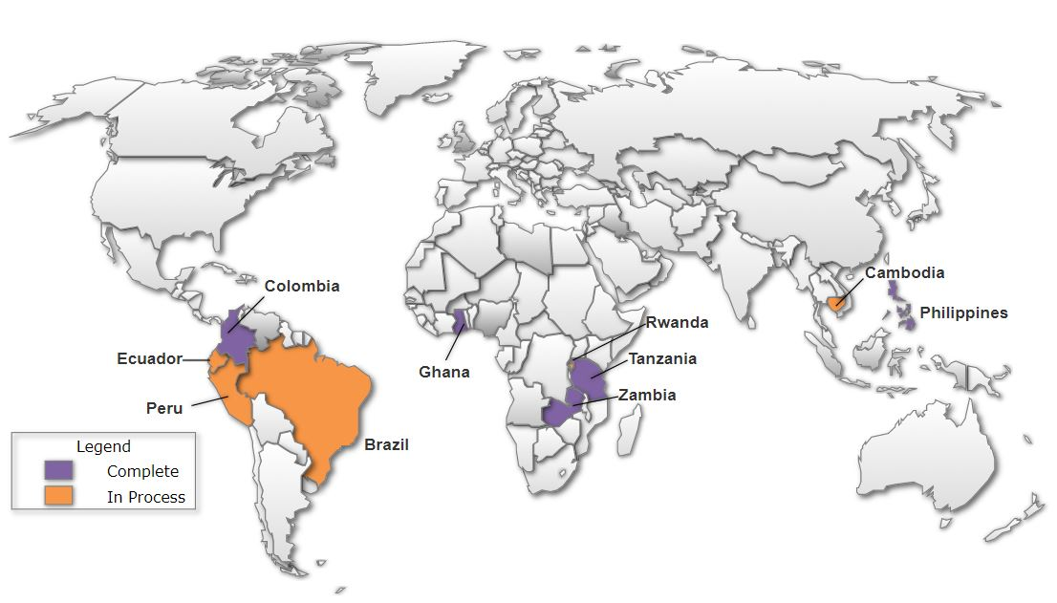
Country Applications to Date

Slide 15
Illustrative Results to Date
Tanzania: Draft Birth, Death and Divorce bill introduced by Government
Colombia: Consolidating >100 CRVS regulations
Ghana: MOU between health sector and Civil Registrar to permit data sharing
Rwanda: Sub-decree authorizing health facilities and CHWs as registration points and notifiers

Slide 16
Questions?
https://www.bloomberg.org/program/public-health/data-health/
www.crvslaws.org
Ashley Frederes
  Afrederes@vitalstrategies.org
Aaron Schwid
  Aschwid@advocacyincubator.org

